Slide 1
Software Testing and Quality Assurance
Theory and Practice
Chapter 3
Unit Testing
Notes:
Handouts
------------------------------------------------------------------
------------------------------------------------------------------
-------------------------------------------------------------------
--------------------------------------------------------------------

Slide 2
Outline of the Chapter
Concept of Unit Testing
Static Unit Testing
Defect Prevention
Dynamic Unit Testing
Mutation Testing
Debugging
Unit Testing in eXtreme Programming
Tools For Unit Testing

Slide 3
Concept of Unit Testing
Static Unit Testing
  Code is examined over all possible behaviors that might arise during run time
  Code of each unit is validated against requirements of the unit by reviewing the code
Dynamic Unit Testing
  A program unit is actually executed and its outcomes are observed
  One observe some representative program behavior, and reach conclusion about the quality of the system
Static unit testing is not an alternative to dynamic unit testing
Static and Dynamic analysis are complementary in nature
In practice, partial dynamic unit testing is performed concurrently with static unit testing
It is recommended that static unit testing be performed prior to the dynamic unit testing
Notes:
Handouts

Slide 4
Static Unit Testing
In static unit testing code is reviewed by applying techniques:
  Inspection: It is a step by step peer group review of a work product, with each step checked against pre-determined criteria
  Walkthrough: It is review where the author leads the team through a manual or simulated executed of the product using pre-defined scenarios
The idea here is to examine source code in detail in a systematic manner
The objective of code review is to review the code, and not to evaluate the author of the code
Code review must be planned and managed in a professional manner
The key to the success of code is to divide and conquer
  An examiner inspect small parts of the unit in isolation
    nothing is overlooked
    the correctness of all examined parts of the module implies the correctness of the whole module
Notes:
Handouts

Slide 5
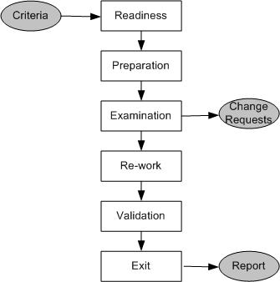
Static Unit Testing (Code Review)
Step 1: Readiness
  Criteria
    Completeness
    Minimal functionality
    Readability
    Complexity
    Requirements and design documents
  Roles
    Moderator
    Author
    Presenter
    Record keeper
    Reviewers
    Observer
Step 2: Preparation
  List of questions
  Potential Change Request (CR)
  Suggested improvement opportunities
Figure 3.1: Steps in the code review process
Notes:
Handouts

Slide 6
Static Unit Testing (Code Review)
Step 3: Examination
  The author makes a presentation
  The presenter reads the code
  The record keeper documents the CR
  Moderator ensures the review is on track
Step 4: Re-work
  Make the list of all the CRs
  Make a list of improvements
  Record the minutes meeting
  Author works on the CRs to fix the issue
Step 5: Validation
  CRs are independently validated
Step 6: Exit
  A summary report of the meeting minutes is distributes
A Change Request (CR) includes the following details:
  Give a brief description of the issue
  Assign a priority level (major or minor) to a CR
  Assign a person to follow it up
  Set a deadline for addressing a CR
Notes:
Handouts

Slide 7
Static Unit Testing (Code Review)
The following metrics can be collected from a code review:
The number of lines of code (LOC) reviewed per hour
The number of CRs generated per thousand lines of code (KLOC)
The number of CRs generated per hour
The total number of hours spend on code review process
Notes:
Handouts

Slide 8
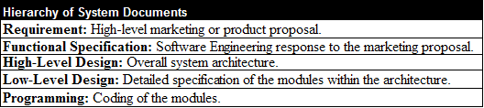
Static Unit Testing (Code Review)
The code review methodology can be applicable to review other documents
Five different types of system documents are generated by engineering department
  Requirement
  Functional Specification
  High-level Design
  Low-level Design
  code
In addition installation, user, and trouble shooting guides are developed by technical documentation group
Table 3.1: System documents
Notes:
Handouts

Slide 9
Defect Prevention
Build instrumentation code into the code
Use standard control to detect possible occurrences of error conditions
Ensure that code exists for all return values
Ensure that counter data fields and buffer overflow/underflow are appropriately handled
Provide error messages and help texts from a common source
Validate input data
Use assertions to detect impossible conditions
Leave assertions in the code.
Fully document the assertions that appears to be unclear
After every major computation reverse-compute the input(s) from the results in the code itself
Include a loop counter within each loop
Notes:
Handouts

Slide 10
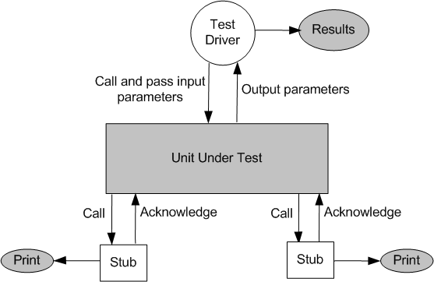
Dynamic Unit Testing
The environment of a unit is emulated and tested in isolation
The caller unit is known as test driver
  A test driver is a program that invokes the unit under test (UUT)
  It provides input data to unit under test and report the test result
The emulation of the units called by the UUT are called stubs
  It is a dummy program
The test driver and the stubs are together called scaffolding
The low-level design document provides guidance for selection of input test data
Figure 3.2: Dynamic unit test environment
Notes:
Handouts

Slide 11
Dynamic Unit Testing
Selection of test data is broadly based on the following techniques:
Control flow testing
  Draw a control flow graph (CFG) from a program unit
  Select a few control flow testing criteria
  Identify a path in the CFG to satisfy the selection criteria
  Derive the path predicate expression from the selection paths
  By solving the path predicate expression for a path, one can generate the data
Data flow testing
  Draw a data flow graph (DFG) from a program unit and then follow the procedure described in control flow testing.
Domain testing
  Domain errors are defined and then test data are selected to catch those faults
Functional program testing
  Input/output domains are defined to compute the input values that will cause the unit to produce expected output values
Notes:
Handouts

Slide 12
Mutation Testing
Modify a program by introducing a single small change to the code
A modified program is called mutant
A mutant is said to be killed when the execution of test case cause it to fail. The mutant is considered to be dead
A mutant is an equivalent tot the given program if it always produce the same output as the original program
A mutant is called killable or stubborn, if the existing set of test cases is insufficient to kill it
A mutation score for a set of test cases is the percentage of non-equivalent mutants killed by the test suite
The test suite is said to be mutation-adequate if its mutation score is 100%
Notes:
Handouts

Slide 13
Mutation testing
Consider the following program P
main(argc,argv)
int argc, r, i;
char *argv[];
{ r = 1;
for i = 2 to 3 do
if (atoi(argv[i]) > atoi(argv[r])) r = i;
printf(“Value of the rank is %d \n”, r);
exit(0); }
Test Case 1:
input: 1 2 3
output: Value of the rank is 3
Test Case 2:
input: 1 2 1
output: Values of the rank is 2
Test Case 3:
input: 3 1 2
output: Value of the rank is 1
Mutant 1: Change line 5 to for i = 1 to 3 do
Mutant 2: Change line 6 to if (i > atoi(argv[r])) r = i;
Mutant 3: Change line 6 to if (atoi(argv[i]) >= atoi(argv[r])) r = i;
Mutant 4: Change line 6 to if (atoi(argv[r]) > atoi(argv[r])) r = i;
Execute modified programs against the test suite, you will get the results:
Mutants 1 & 3: Programs will pass the test suite, i.e., mutants 1 & 3 are not killable
Mutant 2: Program will fail test cases 2
Mutant 4: Program will fail test case 1 and test cases 2
Mutation score is 50%, assuming mutants 1 & 3 non-equivalent
Notes:
Handouts

Slide 14
Mutation testing
The score is found to be low because we assumed mutants 1 & 3 are nonequivalent
We need to show that mutants 1 and 3 are equivalent mutants or those are killable
To show that those are killable, we need to add new test cases to kill these two mutants
First, let us analyze mutant 1 in order to derive a “killer” test. The difference between P and mutant 1 is the starting point
Mutant 1 starts with i = 1, whereas P starts with i = 2. There is no impact on the result r. Therefore, we conclude that mutant 1 is an equivalent mutant
Second, if we add a fourth test case as follows:
Test Case 4:
input: 2 2 1
Program P will produce the output “Value of the rank is 1” and mutant 3 will produce the output “Value of the rank is 2”
Thus, this test data kills mutant 3, which give us a mutation score 100%
Notes:
Handouts

Slide 15
Mutation Testing
Mutation testing makes two major assumptions:
Competent Programmer hypothesis
  Programmers are generally competent and they do not create random programs
Coupling effects
  Complex faults are coupled to simple faults in such a way that a test suite detecting simple faults in a program will detect most of the complex faults
Notes:
Handouts

Slide 16
Debugging
The process of determining the cause of a failure is known as debugging
It is a time consuming and error-prone process
Debugging involves a combination of systematic evaluation, intuition and a little bit of luck
The purpose is to isolate and determine its specific cause, given a symptom of a problem
There are three approaches to debugging
  Brute force
  Cause elimination
    Induction
    Deduction
  Backtracking
Notes:
Handouts

Slide 17
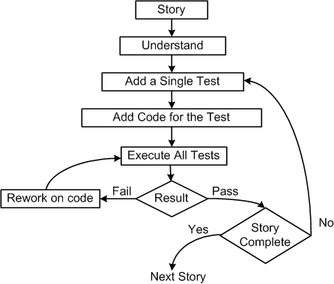
Unit Testing in eXtreme Programming
Pick a requirement, i.e., a story
Write a test case that will verify a small part of the story and assign a fail verdict to it
Write the code that implement particular part of the story to pass the test
Execute all test
Rework on the code, and test the code until all tests pass
Repeat step 2 to step 5 until the story is fully implemented
Figure 3.3: Test-first process in XP
Notes:
Handouts

Slide 18
Unit Testing in eXtreme Programming
Three laws of Test Driven development (TDD)
One may not write production code unless the first failing unit test is written
One may not write more of a unit test than is sufficient to fail
One may not write more production code than is sufficient to make the failing unit test pass
Pair programming:
  In XP code is being developed by two programmers working side by side
  One person develops the code tactically and the other one inspects it methodically by keeping in mind the story they are implementing
Notes:
Handouts

Slide 19
JUnit – A Framework for Unit Testing
JUnit: It is a framework for performing unit testing of Java programs.
  Other frameworks: NUnit (C#), CPPUnit (C++), fUnit (Fortran)
Intuitive steps to test a method in Java (Ex. Move() method of PlanetClass)
  Create an object instance of PlanetClass. Call it Mars.
  Select values of all input parameters of Move().
  Compute the expected value to be returned by Move(). Let it be y.
  Execute method Move() on Mars with the selected input values.
    Let Move() return a value called z.
  Compare the actual output (z) returned by Move() with the expected value (y).
    If (z == y), Move() passes the test; otherwise it fails. ⬅ Report the result.
JUnit makes writing of test cases easier. ➔ Next slide …
Notes:
Handouts

Slide 20
JUnit – A Framework for Unit Testing
JUnit provides a basic class called TestCase.
The tester
  Extends the TestCase class for each test case. 10 extensions for 10 test cases.
  Alternatively, extend TestCase to have 10 methods for 10 test cases.
The TestCase class provides methods to make assertions.
  assertTrue(Boolean condition)
  assertFalse(Boolean condition)
  assertEquals(Object expected, Object actual)
  assertEquals(int expected, int actual)
  assertEquals(double expected, double actual, double tolerance)
  assertSame(Object expected, Object actual)
  assertNull(Object testobject)
  …
The tester can have her own assertions.
Notes:
Handouts

Slide 21
JUnit – A Framework for Unit Testing
Each assertion accepts an optional first parameter of type String; if the assertion fails, the string is displayed. ⬅ Help for the tester…
The assertEquals() method displays a message upon failure.
    junit.framework.AssertionFailedError: expected: <x> but was: <y>
Note that only failed tests are reported.
The following shows how assertTrue() works.
static public void assertTrue(Boolean condition) {
if (!condition)
throw new AssertionFailedError();
}
Figure 3.5: The assertTrue() assertion throws an exception
Notes:
Handouts

Slide 22
JUnit – A Framework for Unit Testing
import TestMe; // TestMe is the class whose methods are going to be tested.
import junit.framework.*; // This contains the TestCase class.
public class MyTestSuite extends TestCase { // Create a subclass of TestCase
public void MyTest1() { // This method is the first test case
TestMe object1 = new TestMe( ... ); // Create an instance of TestMe with desired params
int x = object1.Method1(...); // invoke Method1 on object1
assertEquals(365, x); // 365 and x are expected and actual values, respectively.
}
public void MyTest2() { // This method is the second test case
TestMe object2 = new TestMe( ... ); // Create another instance of
// TestMe with desired parameters
double y = object2.Method2(...); // invoke Method2 on object2
assertEquals(2.99, y, 0.0001d); // 2.99 is the expected value;
// y is the actual value;
// 0.0001 is tolerance level
}
}
Figure 3.5: An example test suite
Notes:
Handouts

Slide 23
Tools For Unit Testing
Code auditor
  This tool is used to check the quality of the software to ensure that it meets some minimum coding standard
Bound checker
  This tool can check for accidental writes into the instruction areas of memory, or to other memory location outside the data storage area of the application
Documenters
  These tools read the source code and automatically generate descriptions and caller/callee tree diagram or data model from the source code
Interactive debuggers
  These tools assist software developers in implementing different debugging techniques
    Examples: Breakpoint and Omniscient debuggers
In-circuit emulators
  It provides a high-speed Ethernet connection between a host debugger and a target microprocessor, enabling developers to perform source-level debugging
Notes:
Handouts

Slide 24
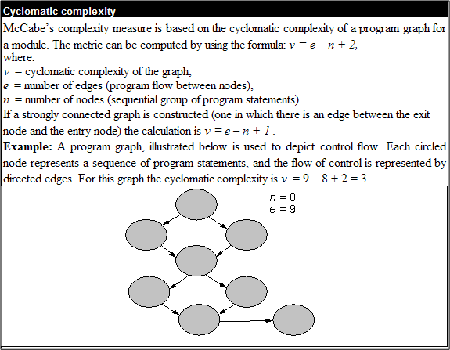
Tools for Unit Testing
Memory leak detectors
  These tools test the allocation of memory to an application which request for memory and fail to de-allocate memory
Static code (path) analyzer
  These tool identify paths to test based on the structure of code such as McCabe’s cyclomatic complexity measure
Table 3.3: McCabe complexity measure
Notes:
Handouts

Slide 25
Tools for Unit Testing
Software inspection support
  Tools can help schedule group inspection
Test coverage analyzer
  These tools measure internal test coverage, often expressed in terms of control structure of the test object, and report the coverage metric
Test data generator
  These tools assist programmers in selecting test data that cause program to behave in a desired manner
Test harness
  This class of tools support the execution of dynamic unit tests
Performance monitors
  The timing characteristics of the software components be monitored and evaluate by these tools
Network analyzers
  These tools have the ability to analyze the traffic and identify problem areas
Notes:
Handouts

Slide 26
Tools for Unit Testing
Simulators and emulators
  These tools are used to replace the real software and hardware that are not currently available. Both the kinds of tools are used for training, safety, and economy purpose
Traffic generators
  These produces streams of transactions or data packets.
Version control
  A version control system provides functionalities to store a sequence of revisions of the software and associated information files under development
Notes:
Handouts

